Slide 1
Snake game

Slide 2


Slide 3
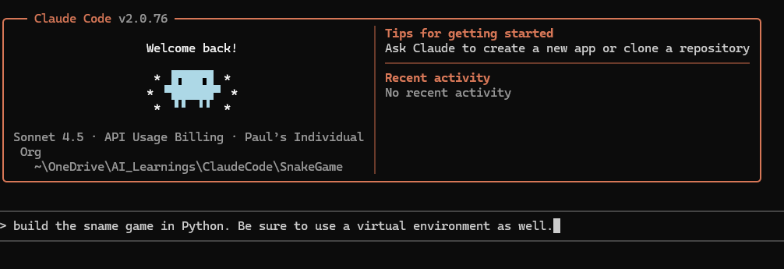
First prompt

Slide 4

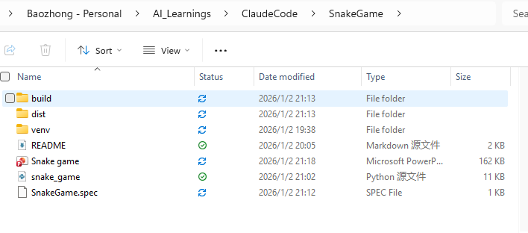
Double click

Slide 5
